Slide 1


Trigeminal neuralgia
Mr. Jeremy Russell
vascular & skull base NEUROsurgeon

Slide 2
overview
Trigeminal Neuralgia overview
Current MVD procedure
Who’s a candidate for an MVD ?
Pain recurrence after an MVD
What if you’re not an MVD candidate ?

Slide 3
Trigeminal Neuralgia
Classification (ICHD-3) :
  Recurrent unilateral brief electric shock-like pains
  Abrupt in onset and termination
  Limited to the distribution of one or more divisions of the trigeminal nerve
  Triggered by innocuous stimuli
Subtypes :
  Primary
    Classical
    Idiopathic
  Secondary
  A) Purely paroxysmal
  B) With concomitant continuous pain
Notes:
Classical : Sx + MRI / intra-op evidence NV compression … atrophy or displacement (not just contact)
Idiopathic : Sx + MRI / intra-op NO evidence NV compression (not just contact)
Secondary : Sx + recognized disease (e.g. tumour, MS, AVM, …)

Slide 4
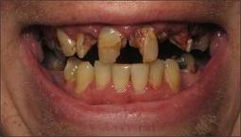
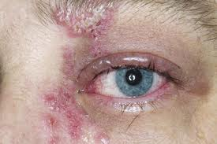
TRIGEMINAL NEURALGIA - DDx
TACs (SUNCT / SUNA)
Dental disease
  Malocclusion or dental abscess
Herpes Zoster
  Pain continuous and can be associated with vesicles and crusting
TMJ pain
Sinusitis
Giant cell arteritis
Migrainous neuralgia
Intracranial tumours
Atypical facial pain
Notes:
Classical : Sx + MRI / intra-op evidence NV compression … atrophy or displacement (not just contact)
Idiopathic : Sx + MRI / intra-op NO evidence NV compression (not just contact)
Secondary : Sx + recognized disease (e.g. tumour, MS, AVM, …)

Slide 5
DIAGNOSIS
History
  100% made on patient history
  Imaging does NOT make the diagnosis !!!
Examination
  Exclude abnormal neurology
MRI
  Exclude tumour / multiple sclerosis
  Look for evidence of NV conflict
  Beware incorrect radiology report

Slide 6
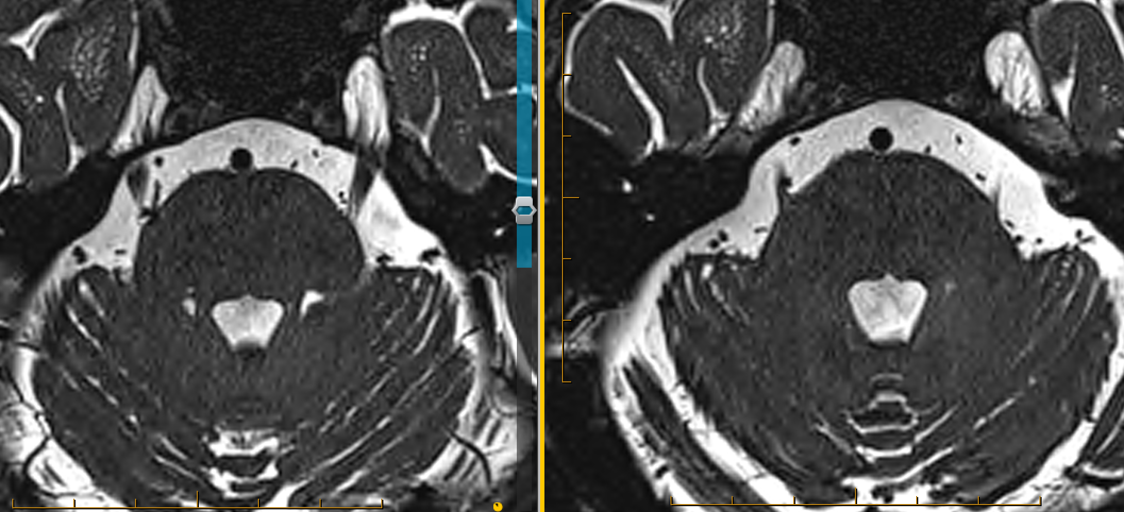

Slide 7
TREATMENT
Medication
  Initial
    (Ox) carbamazepine
    Gabapentin
    Sodium valproate
    Pregabalin
    Lamotrigine
    Botulinum toxin type A
    Vitamin B12 (methylcobalamin 1000 units daily)
  Acute exacerbations
    IV lidocaine
    IV fosphenytoin
    IV ketamine

Slide 8
TREATMENT
Non medical Mx
  MVD
  Percutaneous
    Glycerol
    Balloon
    RF ablation
  Nerve block
  Radiotherapy
Indications
  Failure of medication
  Intolerable side effects of medication
  ? Need for multiple medications

Slide 9
Microvascular decompression (MVD)
General Considerations
  Medication failure / SEs
  Age / Medical comorbidities
  Disease aetioloy (MS, Type 1 & 2 TN)
  Prior trigeminal procedures
  Patient anticoagulation
  Patient preference
MVD
  First choice when applicable
  Most invasive
  Most efficacious
  Most durable

Slide 10
procedure
Pre-op valaciclovir 500mg oral BD (3 days) – if PHx HSV
Stereotaxis
GA
Separate artery (+/- vein) from nerve
Takes 2-3 hours
HDU / ICU post-op first night
Total hospital stay 4-5 days
Risks
  No improvement < 5%
  Facial numbness < 5%
  Facial paralysis < 1%
  Double vision (4th CN palsy) < 5%
  Hearing loss / deafness < 2-3 %
  Major stroke < 1%
  Balance disturbance < 5%
  Bleeding / infection < 1 %
  CSF leak < 5%

Slide 11
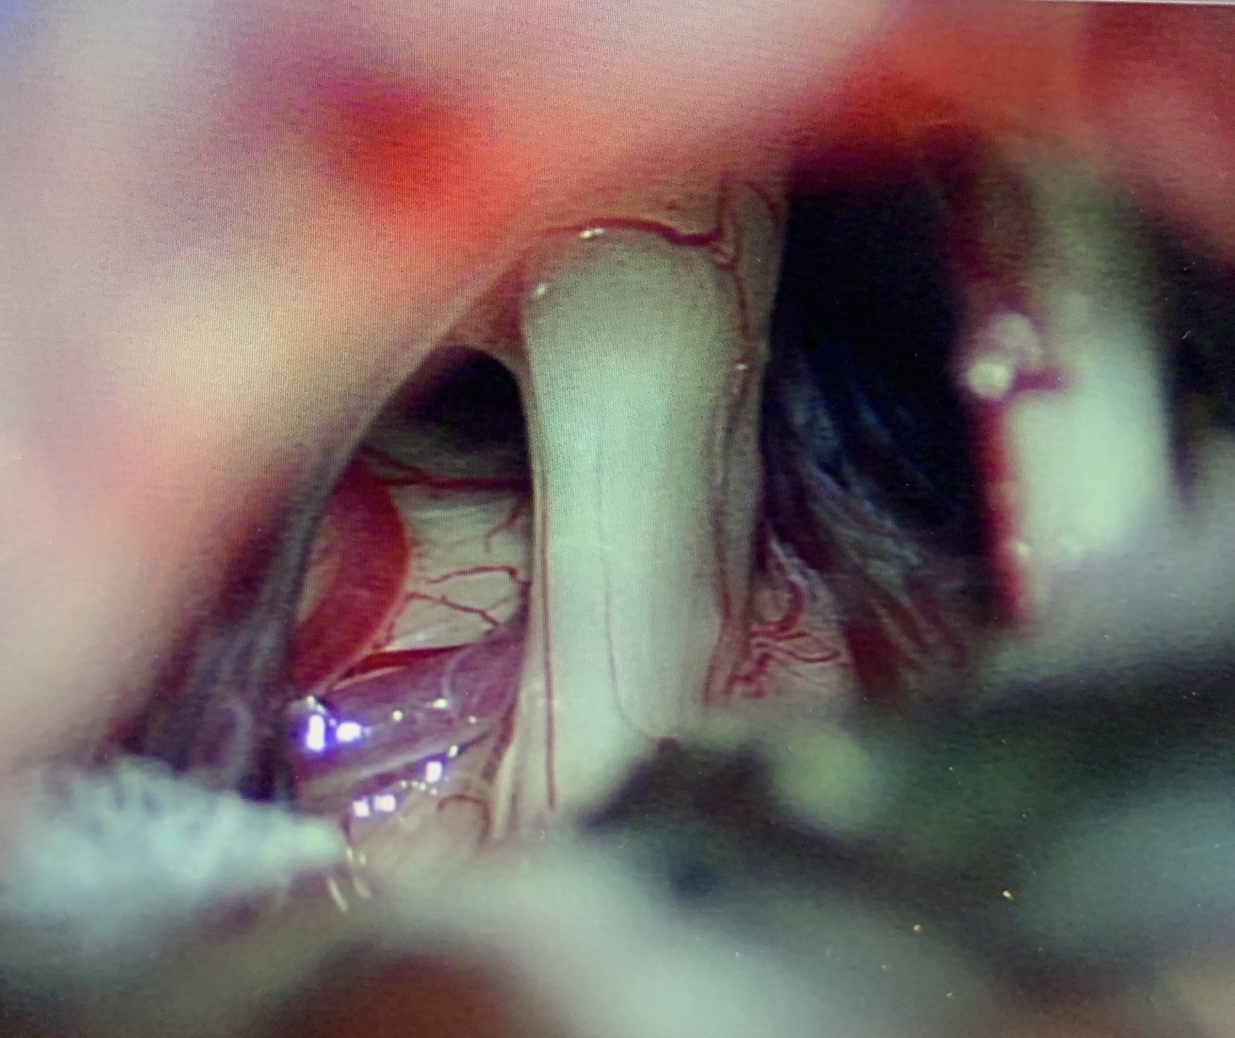

Slide 12
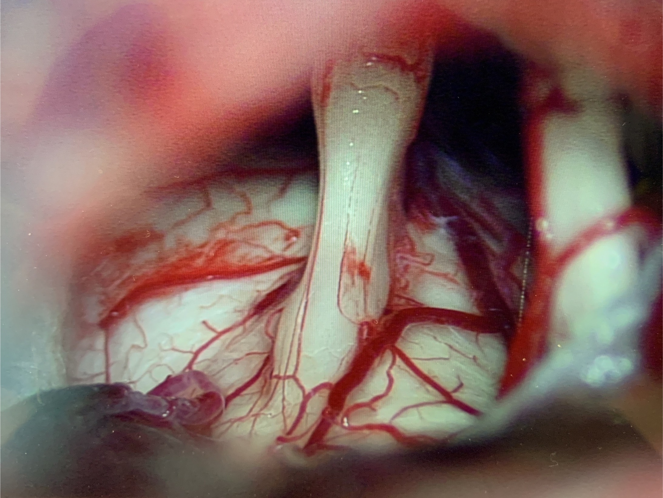

Slide 13
procedure
What if you don’t see anything on the MRI ?
  50% cases still find a vessel
What if you don’t find anything during exploration ?
  “Neurosurgical kiss”
  “Nerve combing” / internal neurolysis
  Very high likelihood facial numbness
  70% chance pain freedom post-op off all meds (BNI grading 1)
  ? Higher recurrence rate
  Limited data available

Slide 14
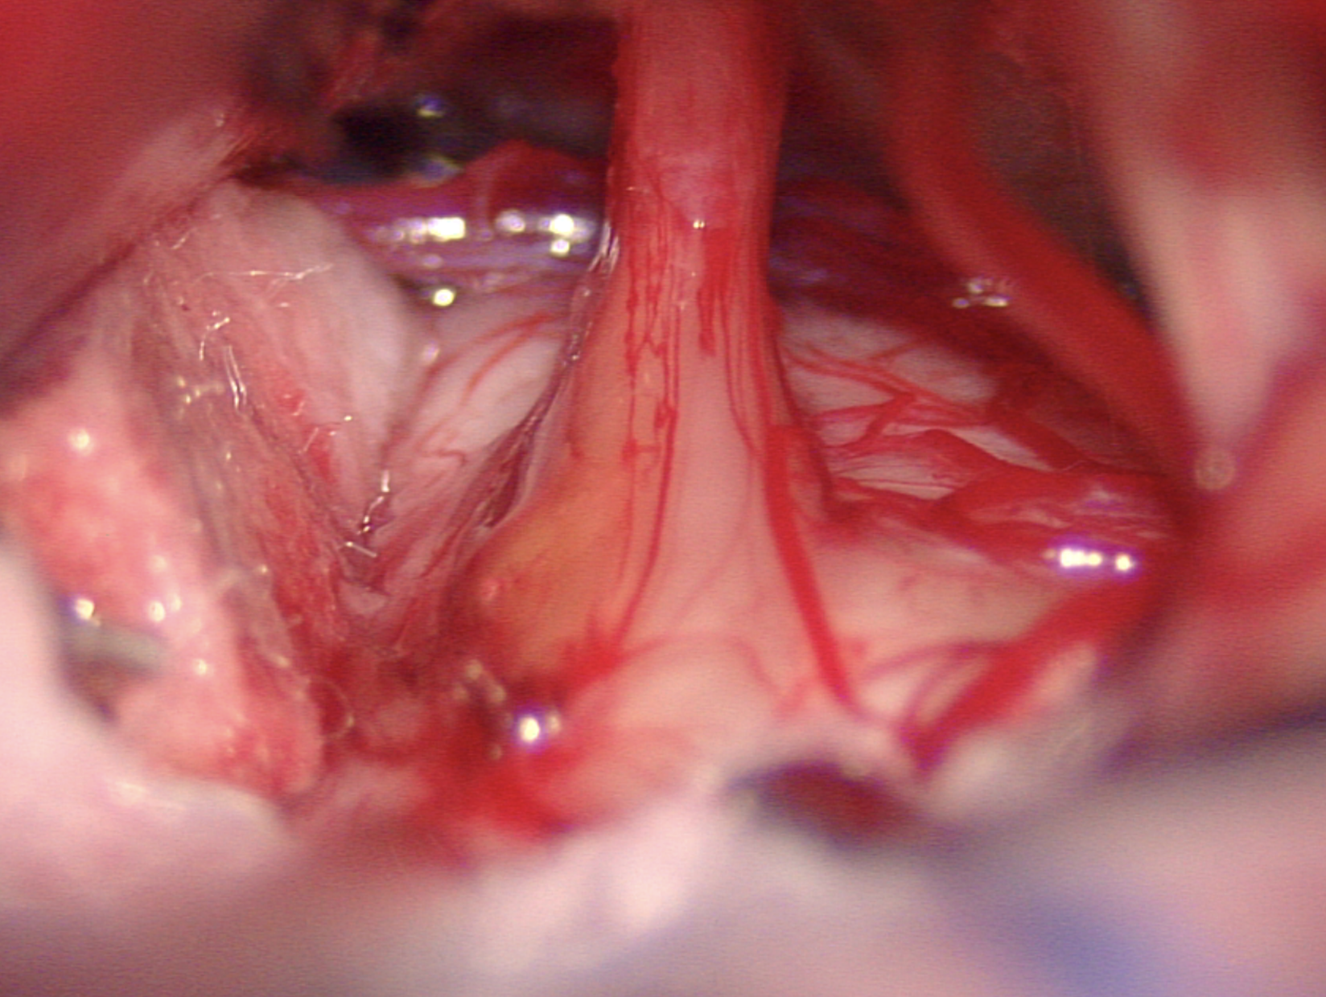

Slide 15
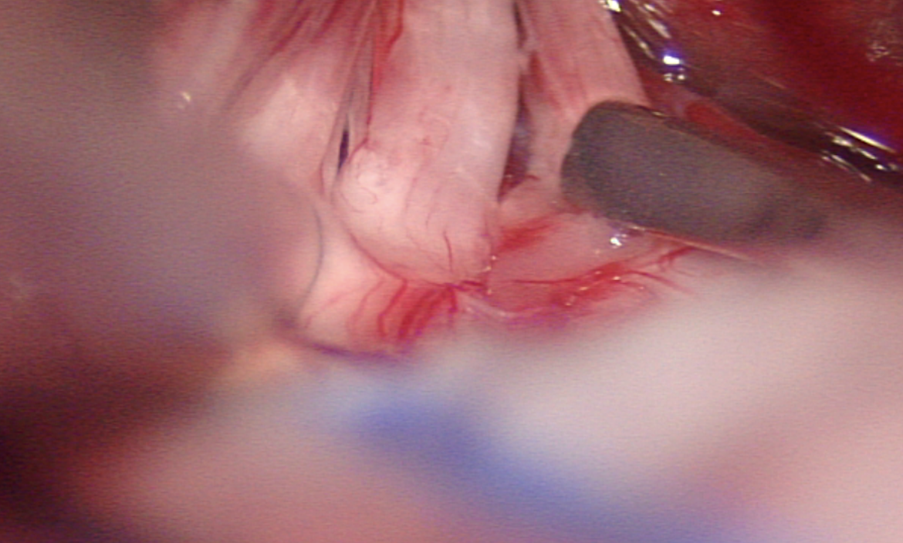

Slide 16
Options if pain recurs after an MVD

Slide 17
Steps if pain recurs after mvd
Hx
  Current type of neuralgia
  Duration of pain freedom after initial MVD ?
  What was found at initial operation ?
    Artery / vein / other
    Get original operation report
    Who was the surgeon ?
  Other pertinent information
    Recent Covid infection / vaccination

Slide 18
Steps if pain recurs after mvd
Imaging
  Repeat MRI with appropriate sequences
    High resolution volumetric T2 posterior fossa sequence (CISS / FIESTA)
    Imaging in 3 planes (axial / coronal / saggital)
    MRA-TOF
    DWI / ADC
  Look for :
    Neurovascular conflict
    Tumours
    MS
    Stroke

Slide 19
Steps if pain recurs after mvd
Options
  Medication
  Surgical intervention
  Stereotactic radiosurgery (SRS)
If MRI shows obvious cause
  Consider redo MVD (should respond like first time)
If MRI does NOT show obvious cause
  Still can consider reoperation
    May find something
    Internal neurolysis AKA “Nerve combing”

Slide 20
Steps if pain recurs after mvd
If MRI does NOT show obvious cause and do NOT want redo MVD
Percutaneous treatments (all around 75% efficacious)
  Glycerol
    Pro : Less numbness / overall SEs
    Con : Less durable
  Balloon
    Pro : More durable
    Con : More numbness, SEs (V1 numbness, chewing weakness, double vision)
  Radio Frequency Ablation (RFA)
    Pro: Can direct to specific region, typically durable
    Con: More involved procedure, need to wake patient up
SRS
  Pro : Least invasive, less facial numbness, can remain on blood thinners
  Con : Least durable

Slide 21
Glycerol indications
General Considerations
  Medication failure / SEs
  Age / Medical comorbidities
  Disease aetioloy (MS, Type 1 & 2 TN)
  Prior trigeminal procedures
  Patient anticoagulation
  Patient preference
Glycerol
  Unable to tolerate MVD
  Prior failed MVD
  MS / ? Type 2 TN
  Patient preference

Slide 22
procedure
Pre-op valaciclovir 500mg oral BD (3 days)
Often day case
“Twilight” anaesthesia / GA in operating room
On recovery bed
Stereotaxis & lateral X-ray
Betadine, bite block, landmarks
Local anaesthetic (Lignocaine + Ad), ? 0.4mg atropine
Needle (18-20G) placement (medial half of foramen ovale)
CSF
Sit up - cisternography (Omnipaque 300 0.2 – 0.5ml)
Lie down, drain Omnipaque
Sit up - glycerol injection (0.2 – 0.5ml)
Keep up for 2 hours post injection (3 pillows)
Check trigeminal function (corneal reflex) before discharge
May take 1 - 2 weeks to work

Slide 23
Glycerol - efficacy
Highly variable results in literature …
Initial efficacy
  Technique (cystogram)
  84 - 91%
Recurrence rate
  18.5 – 50 % at 18 months
Half life
  16 - 24 months
Predictors of success
  Initial pain on infiltration
  Facial hypesthesia
  Type 1 TN
Notes:
Burchiel et al, J Neurosurg 63:784-788, 1985

Slide 24
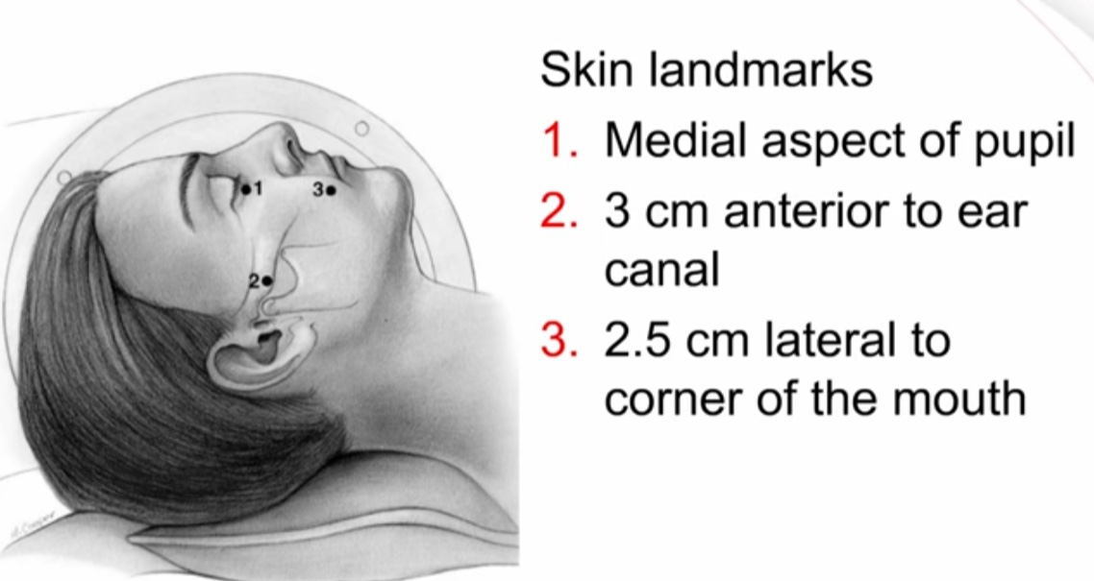

Slide 25
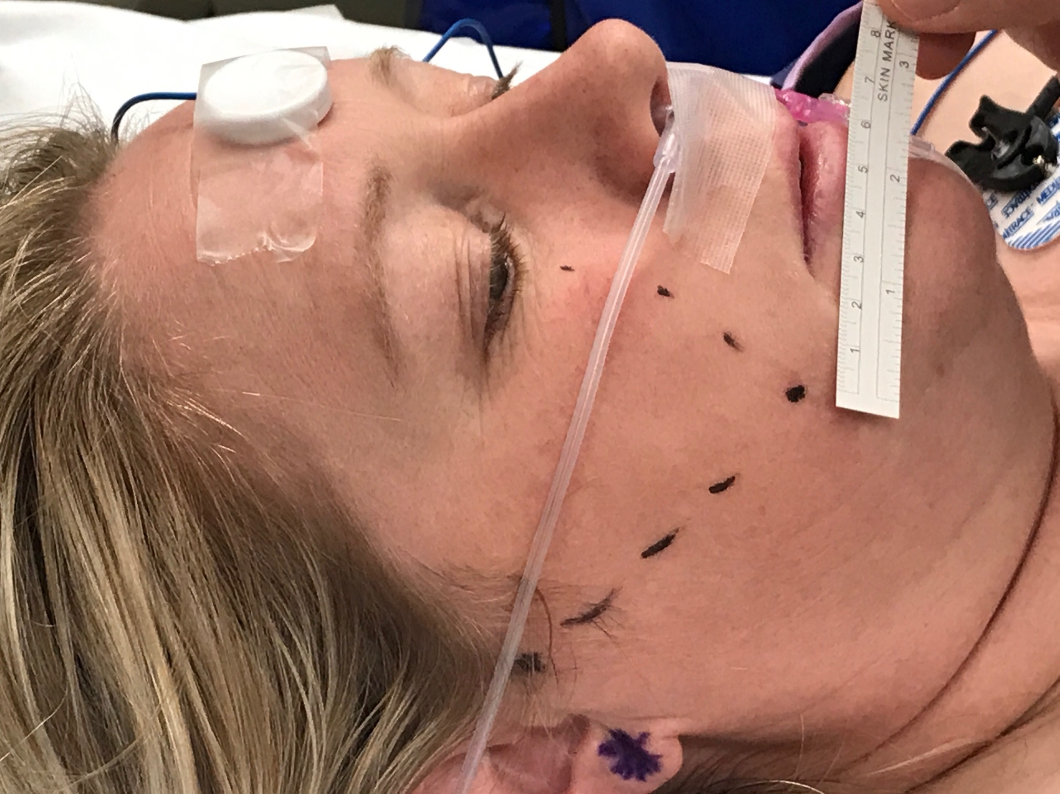

Slide 26
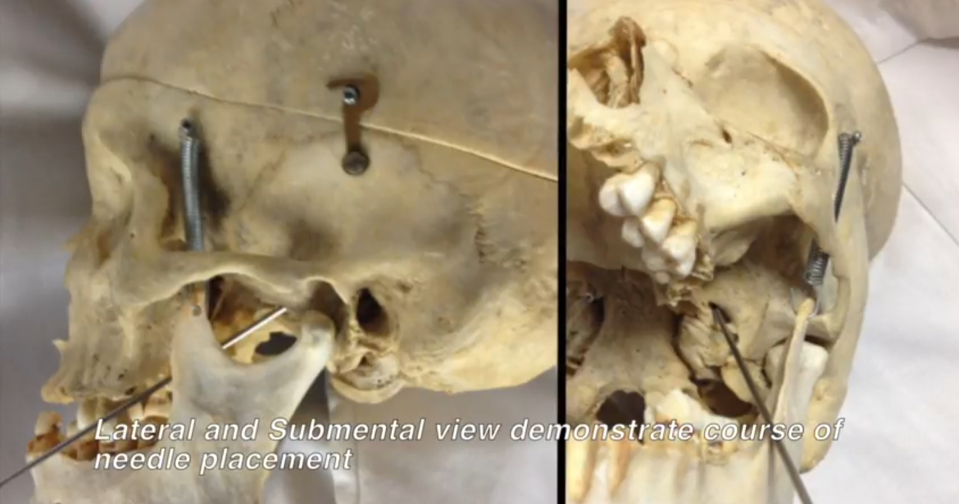

Slide 27
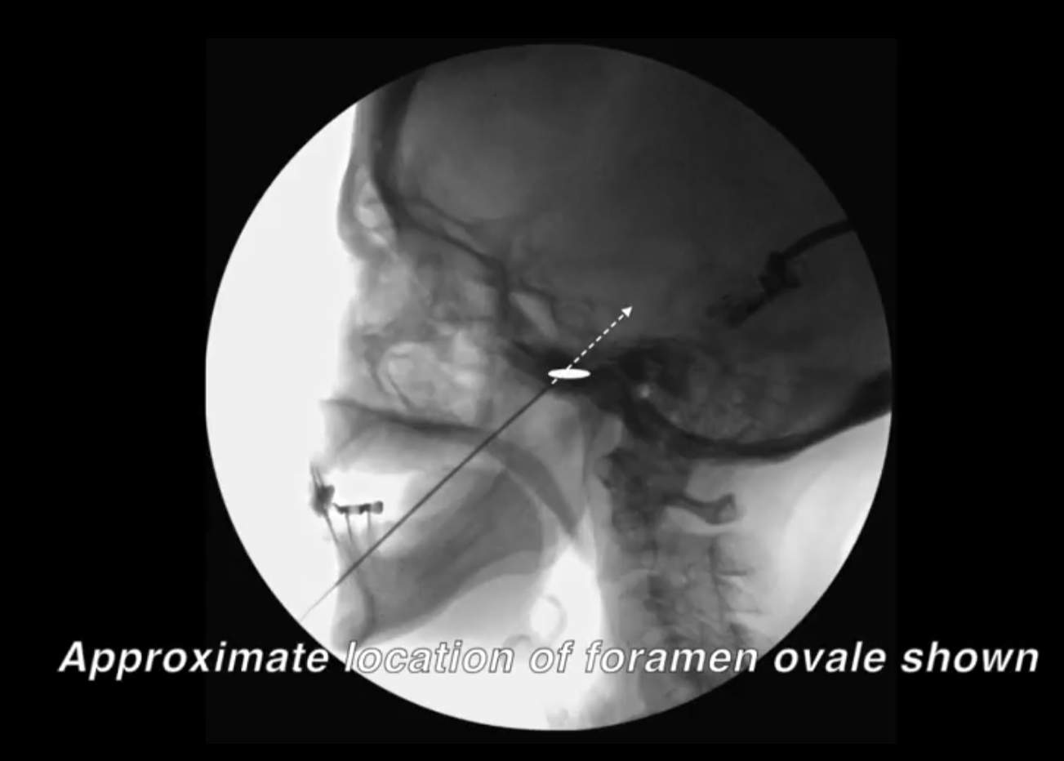


Slide 28
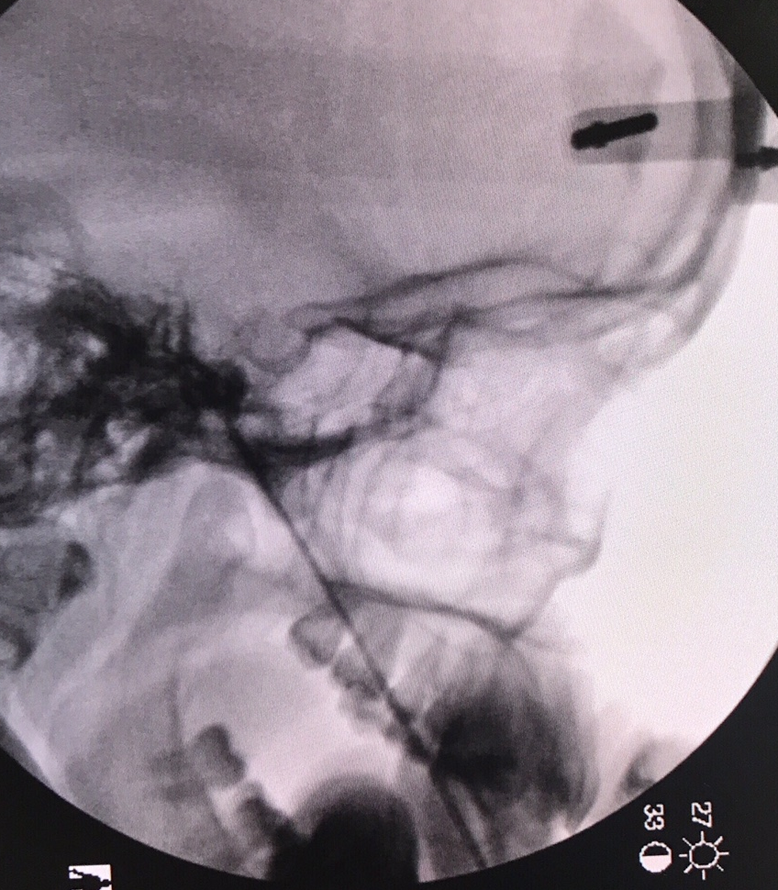
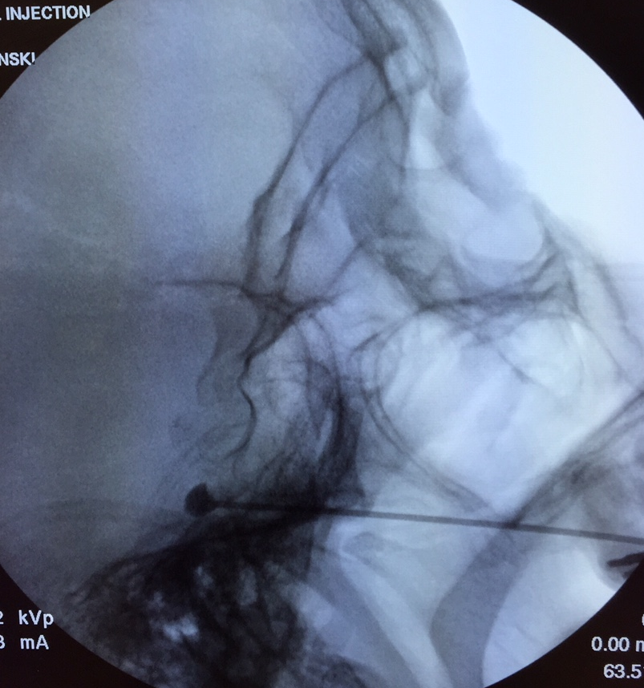

Slide 29
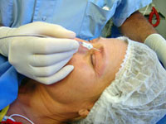
Nerve block / ablation
Limited to certain nerves
  Supraorbital / supratrochlear
  Infraorbital
  Mental
High rates or recurrence
Rarely indicated

Slide 30
Stereotactic Radiosurgery (SRS)
Cyber / Gamma Knife
Typically single fraction 90 Gy to cisternal segment
Non-invasive
Delayed response (Several days to weeks)
Similar efficacy to percutaneous procedures
Can be repeated 1-2 times
Indications
  Patients who can’t come off blood thinners
  Elderly
  Don’t want an invasive procedure of any kind
Similar SEs to percutaneous procedures
Notes:
Burchiel et al, J Neurosurg 63:784-788, 1985

Slide 32
Questions ?
Thank you
Notes:
Radiofrequency lumbar facet denervation has been evaluated in a prospective double blind RCT (Van Keef at al 1999 Spine 24: 1937-42
At 3,6,12 mo significantly more successful Rx pts in RF arm than sham
But only 31 pts in study!
There are some surgeons who would fuse for facet joint pain; no RCT exist
?trial percutaneous fusion
?trial immobilization

