Slide 1


Trigeminal Neuralgia Association Australia Melbourne 2023 Volunteer Workshop
How to navigate the Associations website
https://tnaaustralia.org.au

Slide 2
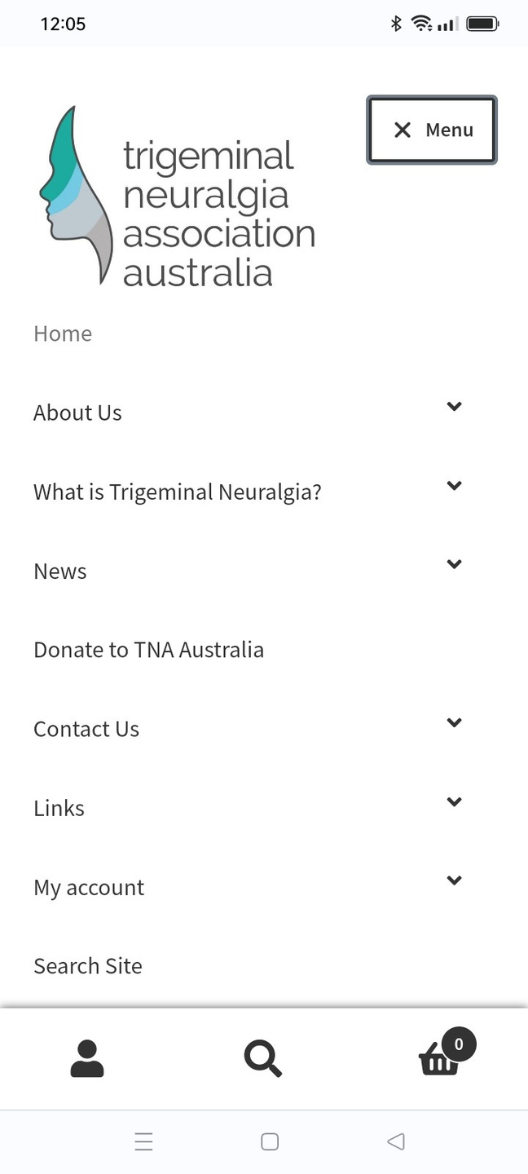
Sections of the Website
  Home
  About Us
  What is Trigeminal Neuralgia
  News
  Donate to TNA Australia
  Contact Us
  Links
  My Account
  Search Site

Slide 3
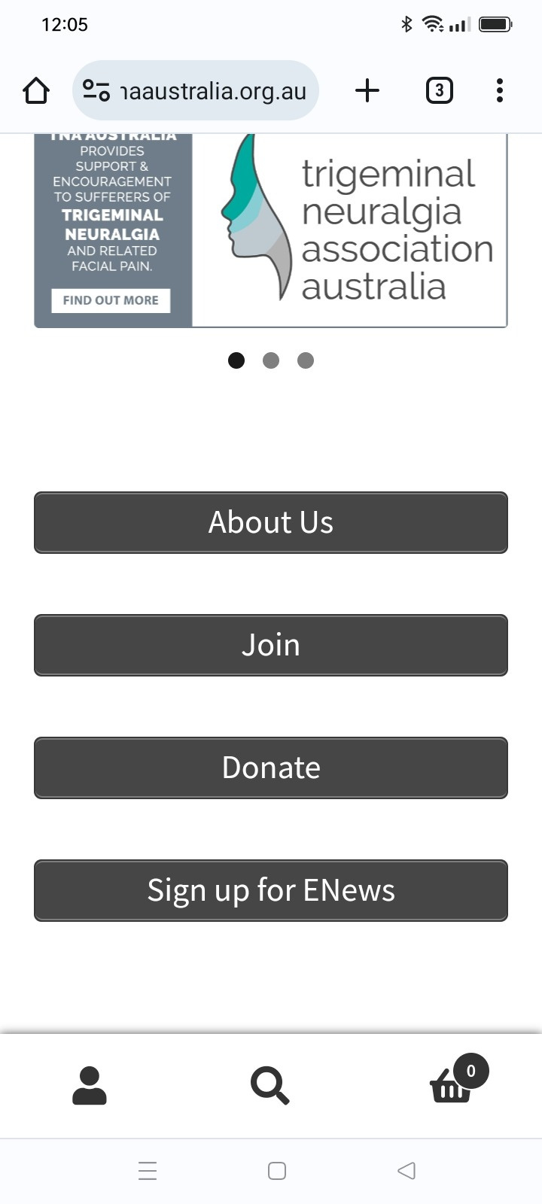
Home - This is the opening screen for the website. The screen displays 4 key menus
  About Us - details of the association
  Join - link to membership
  Donate - link to donate
  Sign up for ENews - link to the newsletter sign up

Slide 4
Section 1 - About Us
How to navigate the Associations website
https://tnaaustralia.org.au

Slide 5
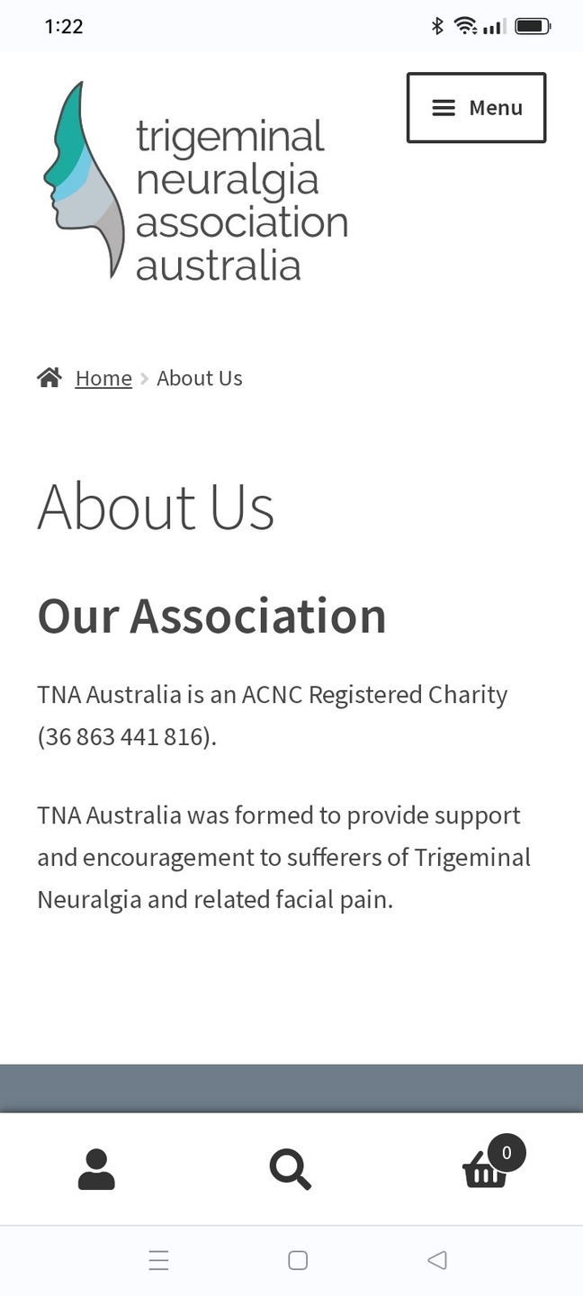
About Us - High Level Section Click the menu to get all the information on this subject.
  Charity Information
  Vision Statement - Objective, Mission, Goal, Vision
  Our Story - Irene wood “The Founder’s” story
scroll down to the page to see all information

Slide 6
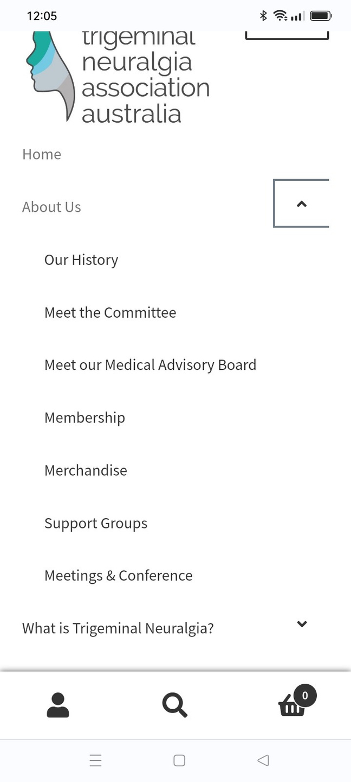
About Us - Lower Level Sections
Click the menu arrow to show all sub headings. Let us explore the quick links to the information.
  Our History
  Meet the Committee
  Meet our Medical Advisory Board
  Membership
  Merchandise
  Support Groups
  Meetings and Conference

Slide 7
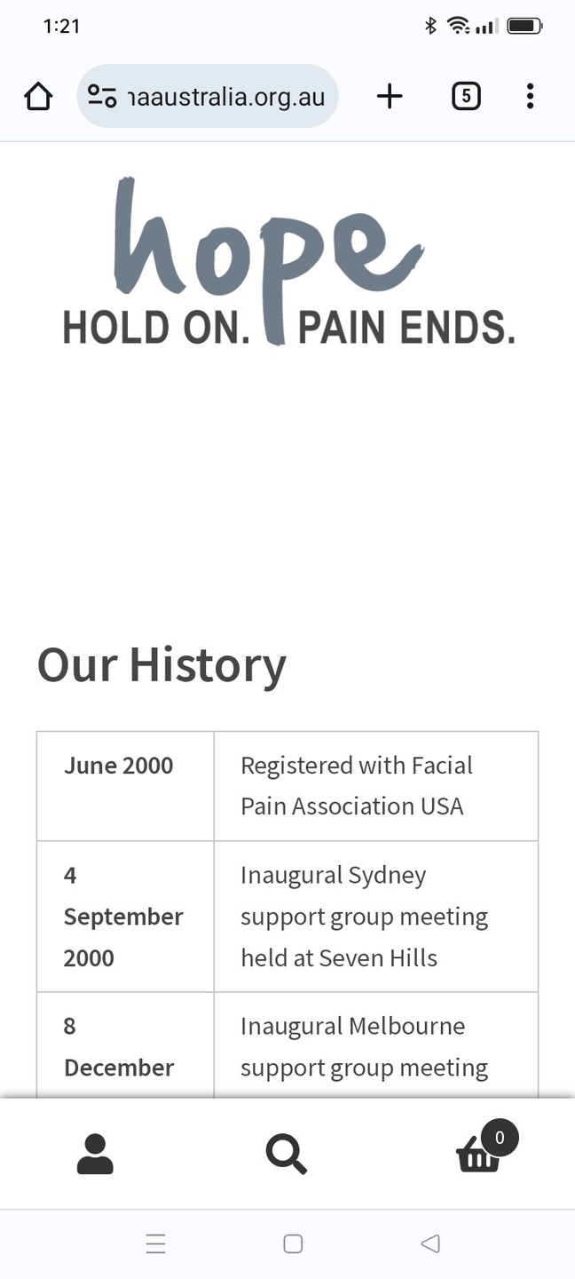
Our History
This section of the website displays the many achievements of the Association from conception to current day
This data can be used to act as background to fund raising or applications of grants
scroll down to the page to see all information

Slide 8
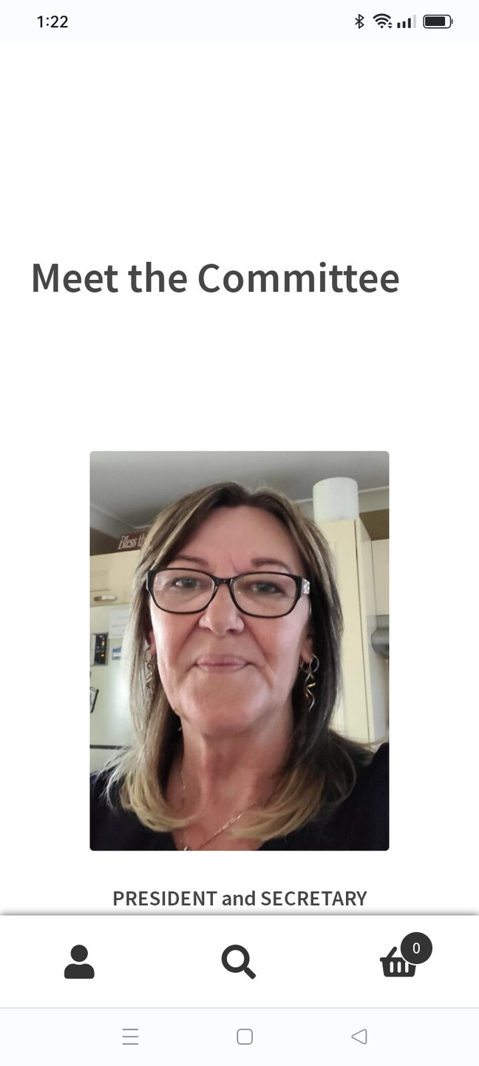
Meet the Committee - click this link
All committee members volunteer their time - they do not recieve any renumeration
Information about each committee member is
  Current picture
  Their role
  Election date
  Information about their background and passions
scroll down to the page to see all information

Slide 9
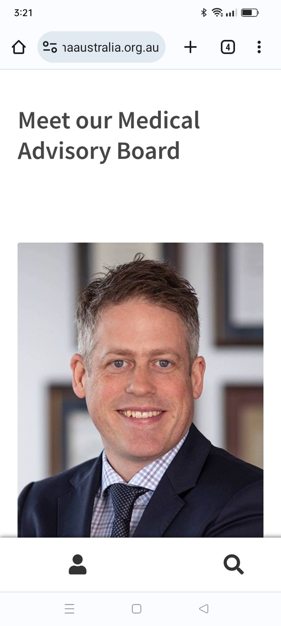
Meet the Medical Advisory Board - click this link
All members of the Medical Advisory Board volunteer their time - they do not recieve any renumeration
Information about each member is
  Current picture
  Their current role
  Where they practise
  Information about their career
scroll down to the page to see all information

Slide 10
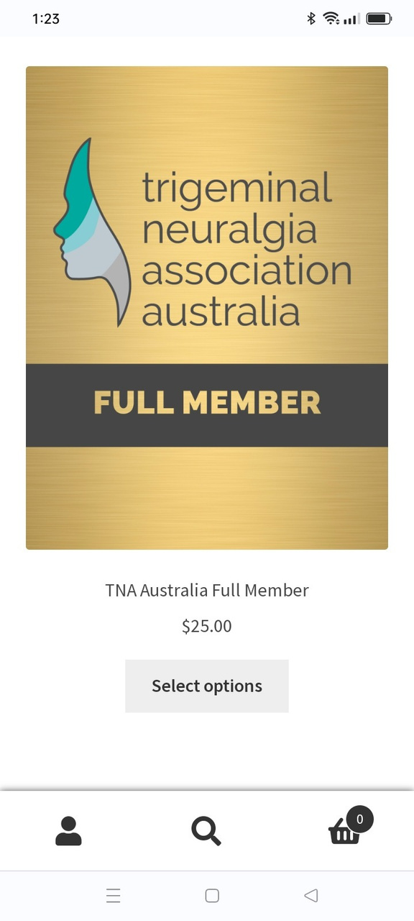
Membership- click this icon
Click the link to be taken to the ist of available memberships
  Full Member - $25 - the cost of the annual membership which runs from the date payment was made
  Sponsor a Member - donating a membership to someone who is financially stressed
scroll down to the page to see all information

Slide 11
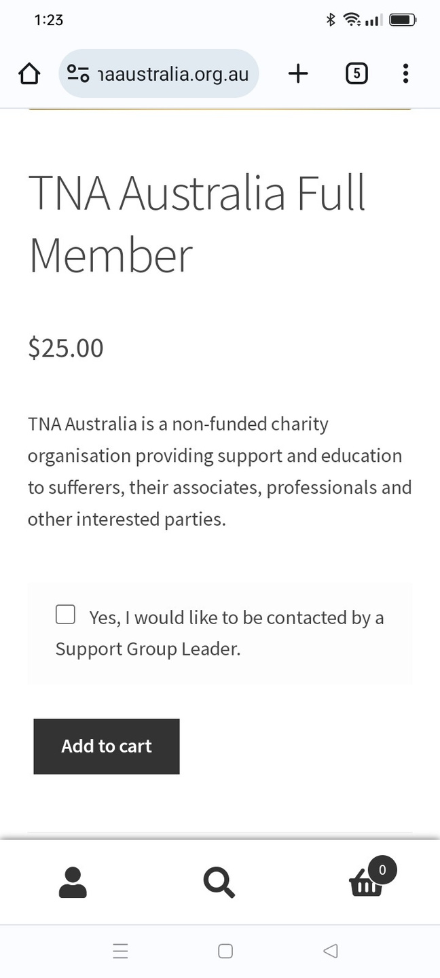
TNA Australia Full Member- click add to cart to start the purchase
When a new membership or renewal is made the user gets the option to click the link for a support Group Leader to contact them
Kim our President currently fulfills this support

Slide 12
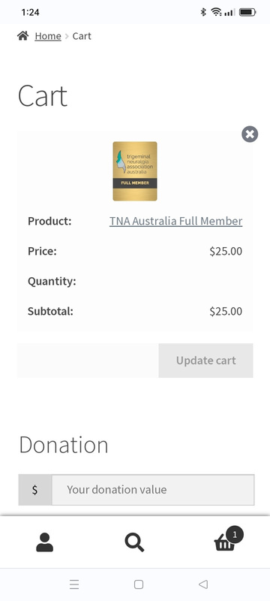
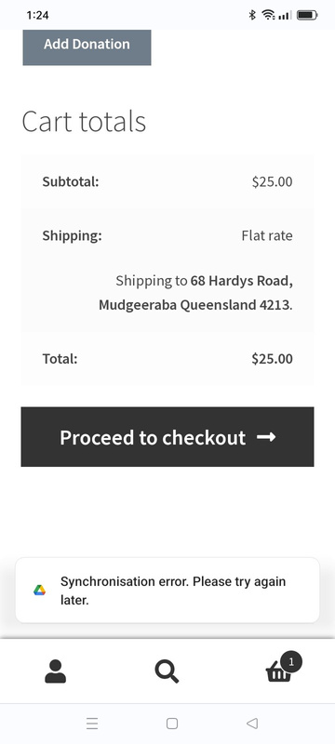
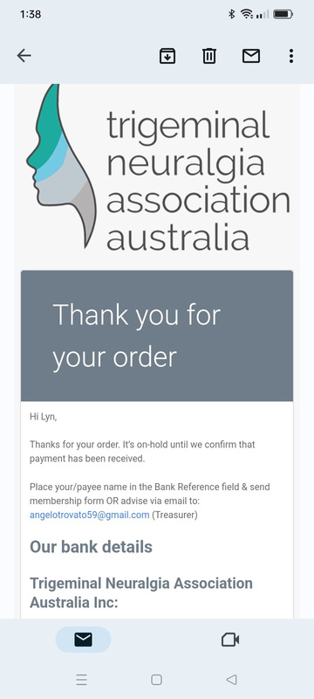
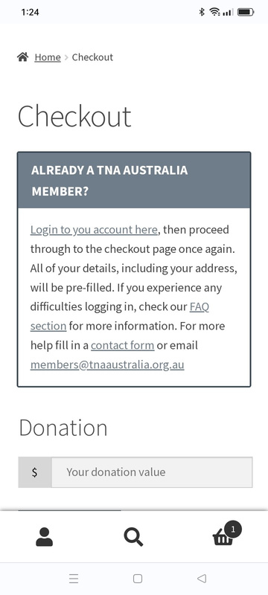
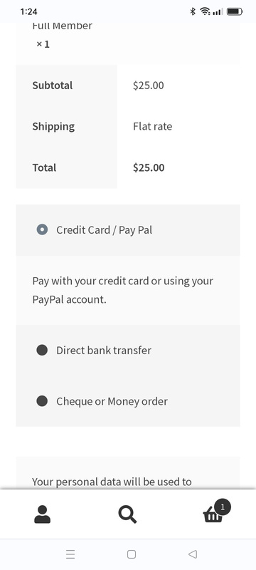
Paying for a Membership Online
  Scroll down to proceed to Checkout
  If you already have an account login, using your Username and password
  Choose how you wish to pay
  When successful you will be sent an email with the order details.
  Users can also fill in “apply for membership” form
If a member has an issue or has made a mistake email membership@tnaaustralia.org.au to be corrected

Slide 13
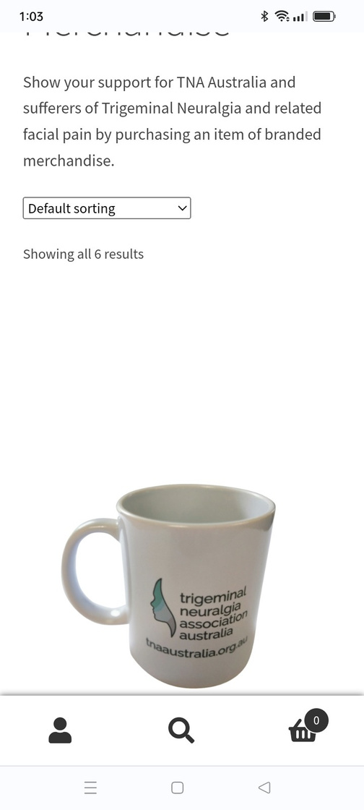
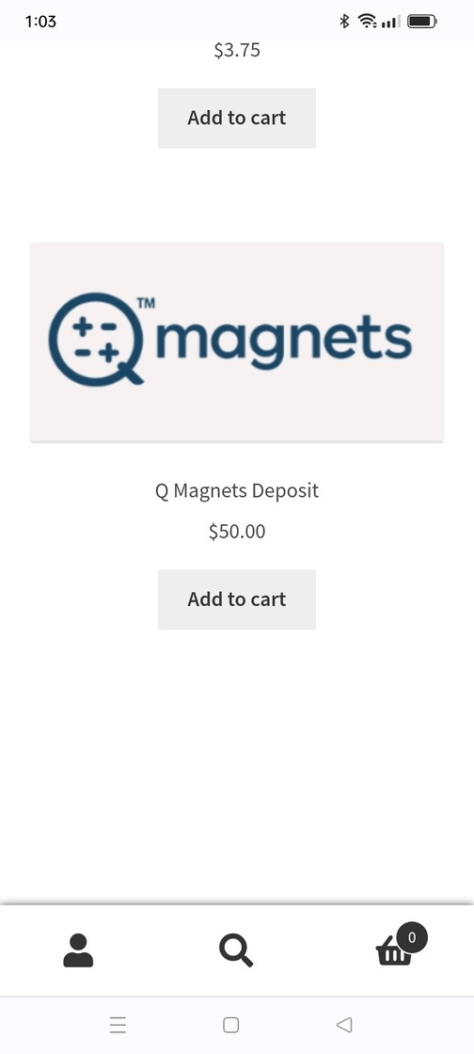
Merchandise - Click link
  Follow the same process to purchase merchandise - scroll down the page to see all product.
  If a purchase is made by bank deposit or cheque - product will not be despatched untill funds have cleared

Slide 14
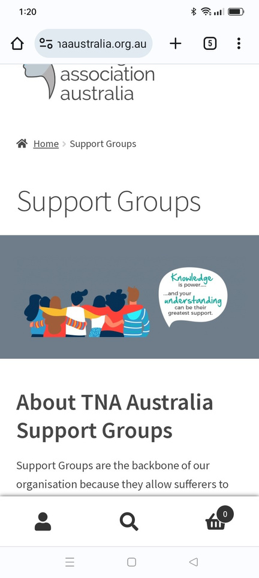
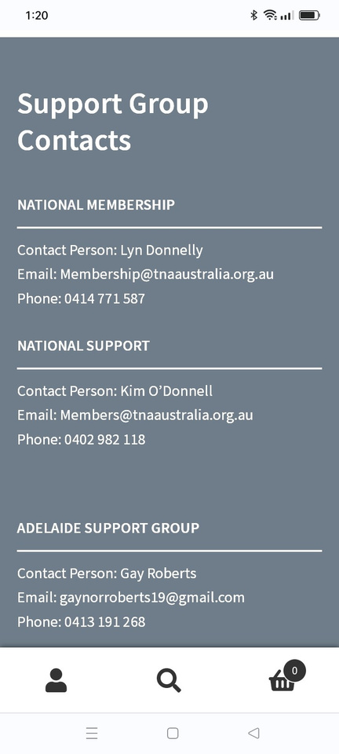
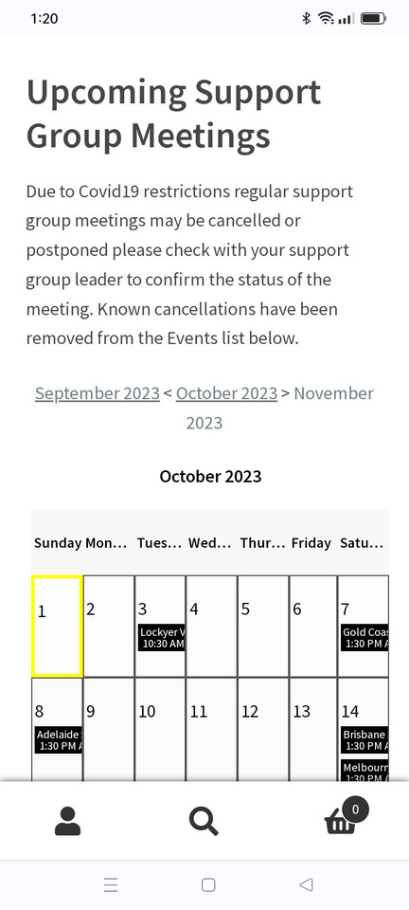
Support Groups - Click link
Scroll down the page to see all sections
  About TNA Australia Support Groups - details of why we use support groups
  Support Group contact details
  Upcoming Support Group Meetings - a calender view by month

Slide 15
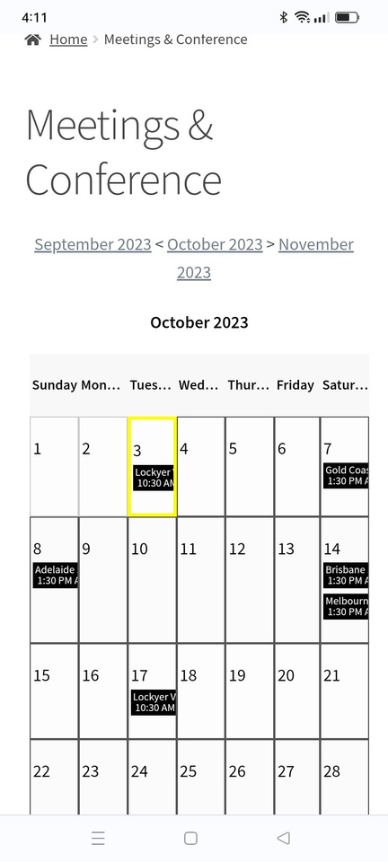
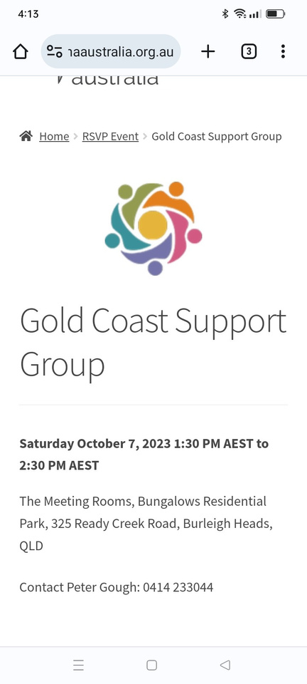
Meetings and Conference - Click link
This link takes the user directly to the calender view
  All events for the month on display
  Click on an event to see the details
currently the RSVP function is not working - we are exploring a paid plugin rather than the free option currently used

Slide 16
Section 2 - What is Trigeminal Neuralgia
How to navigate the Associations website
https://tnaaustralia.org.au

Slide 17
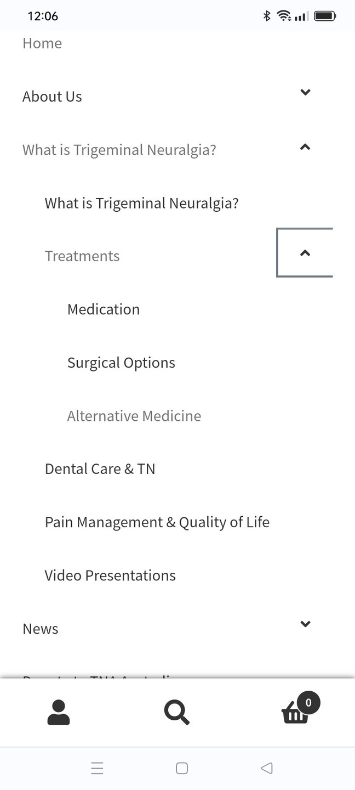
What is Trigeminal Neuragia - High Level
If you click on the high level menu you can scroll down the page to see all of the information
However the website is split into the following headings
  What is Trigeminal Neuralgia
  Treatments
  Dental Care and TN
  Pain Management and Quality of Life *
  Video Presentations *
* represents where articles are regularly added to the menu

Slide 18
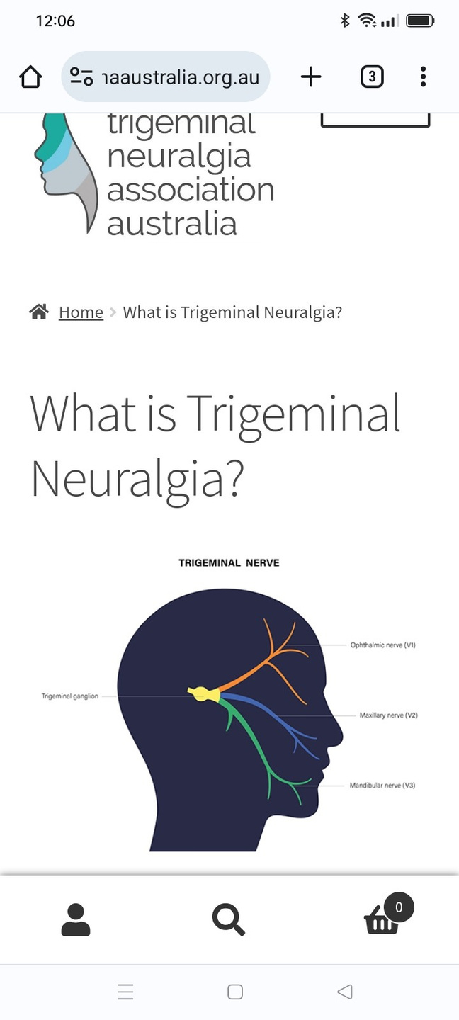
What is Trigeminal Neuragia - Low Level
This section describes medical information about TN
  Statistics
  Medical diagnosis
  Pain triggers
  Other Cranial Neuralgias
  Related Facial Disorders
Users can use the symptom list to evaluate what they are experiencing

Slide 19
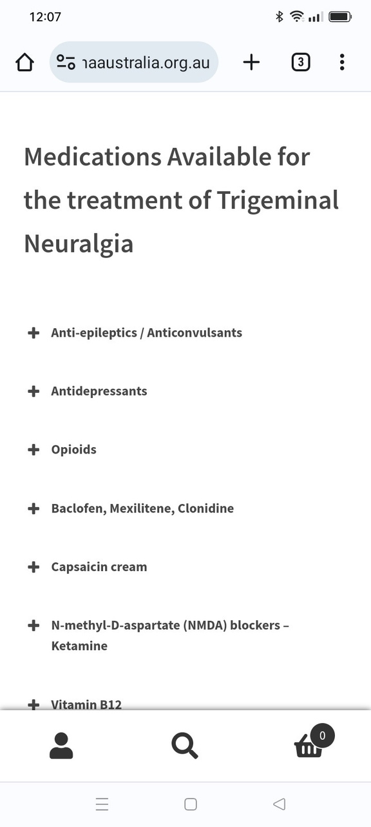
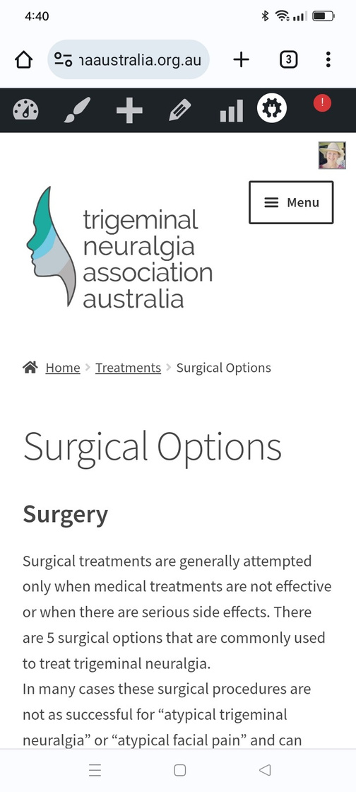
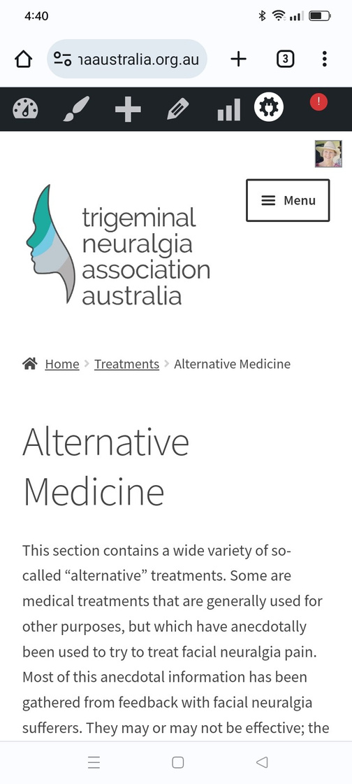
Treatment - High Level
This section describes medical treatment for TN
  Medication - split into various sub-sections (click on the + sign to open section)
  Surgical Options
  Alternative Medication
Each section explores current treatments in depth

Slide 20
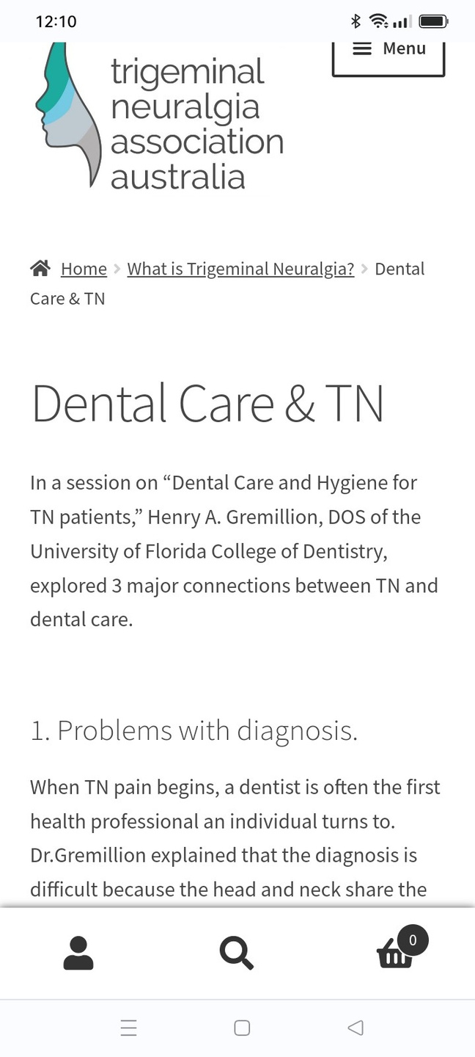
Dental Care and TN
This section describes dental options to review
  Problems with diagnosis
  Dental treatment causing TN
  Dental procedure issues
  Pre-empting pain
  Home dental care tips
  Preventing TN flare-ups after dental work

Slide 21
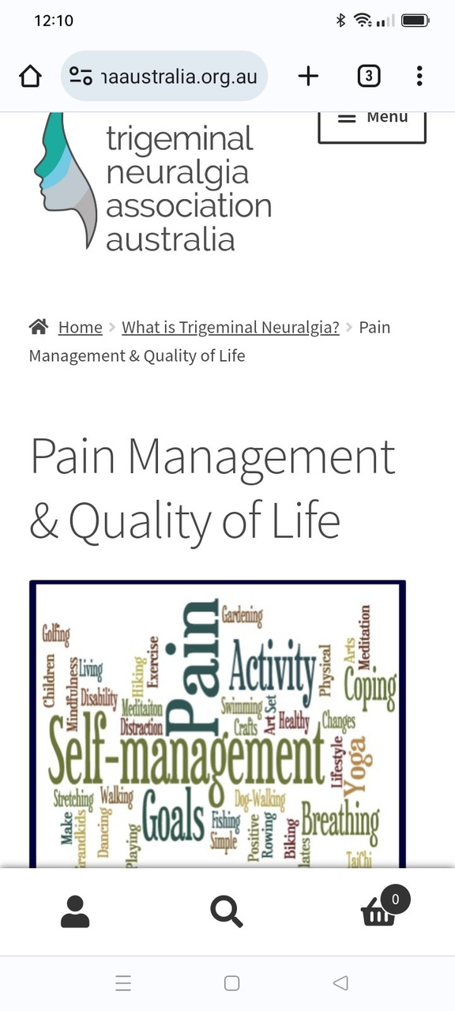
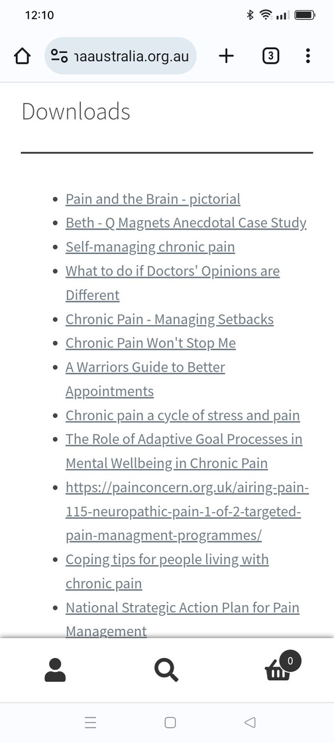
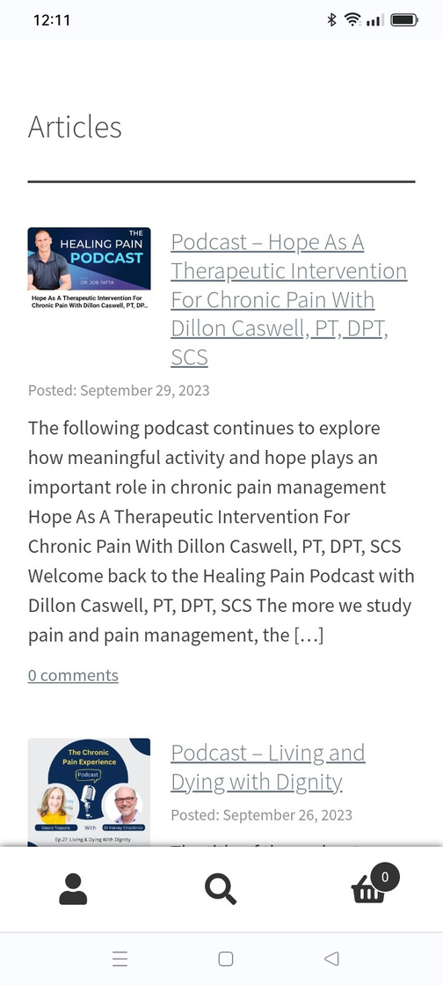
Pain Management and Quality of Life *
This section is regulary updated with interesting articles and podcast links with advice and guidance how to live your best life despite chronic pain
The first section on the page shows download resources available to utilise for education and support

Slide 22
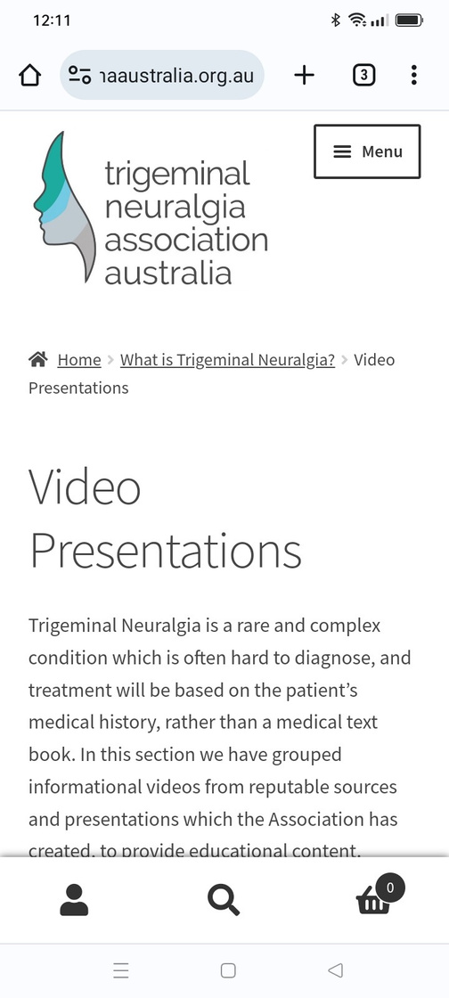
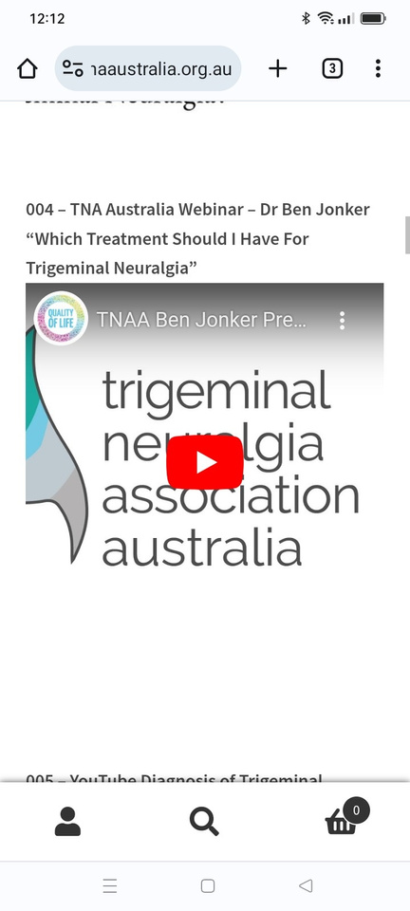
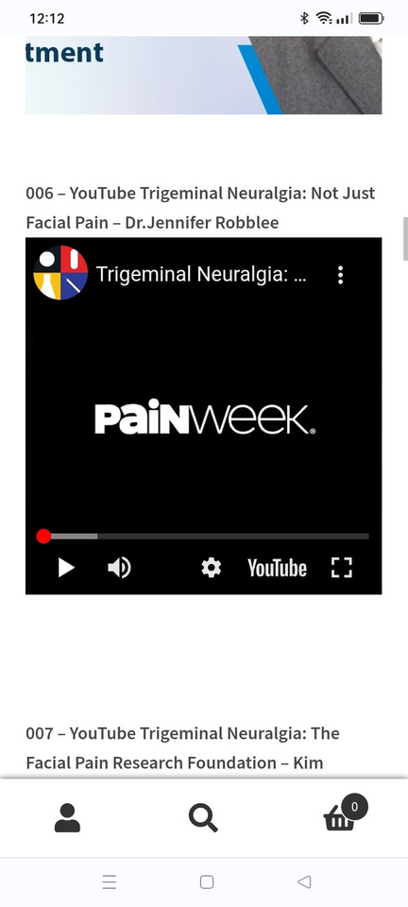
Video Presentations *
This section is regularly updated with interesting web presentations and videos.
TNAA webinar recordings can be found on this page along with other organisations content
Scroll down the page to see all videos

Slide 23
Section 3 - Latest News and Articles
How to navigate the Associations website
https://tnaaustralia.org.au

Slide 24
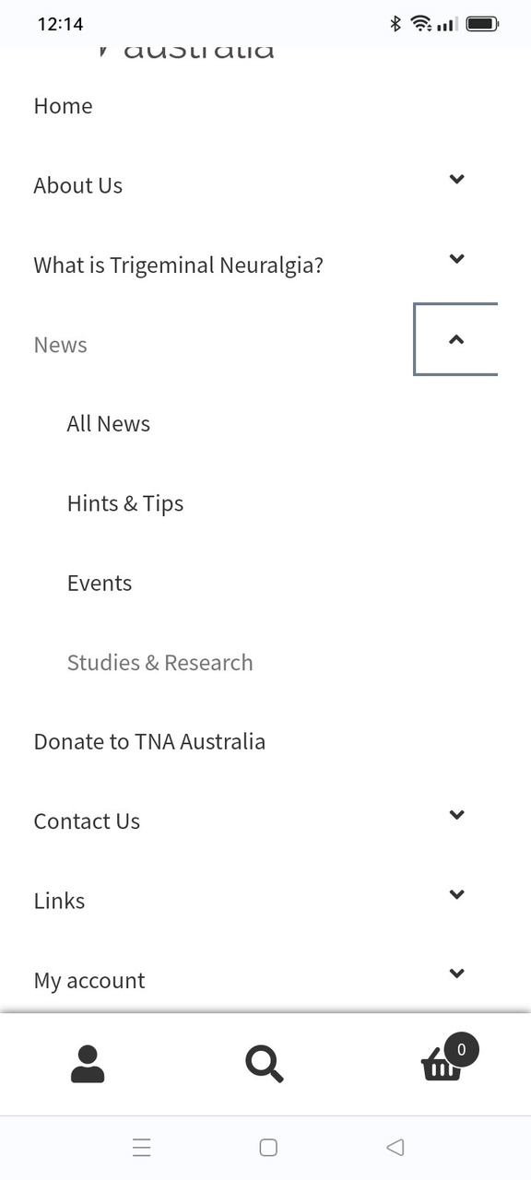
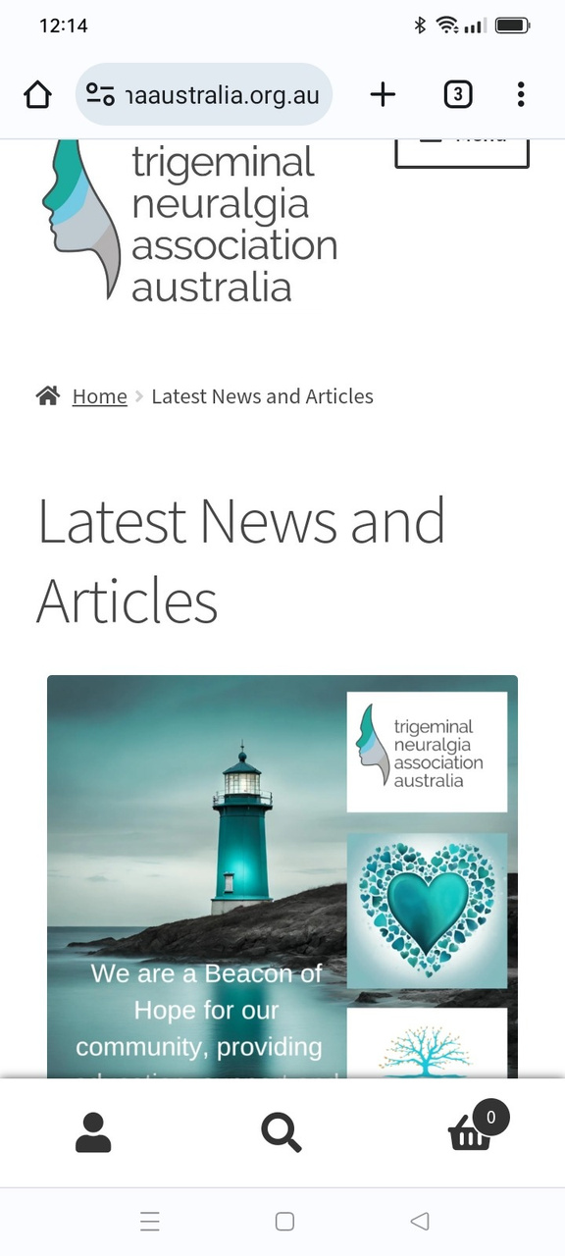
News * - High level
The first part of the page covers
  Beacon of Hope image
  You are not Alone animation
  Light up in Teal 2022/2023 Campaign
The next section is regulary updated with interesting articles research papers and podcasts and is broken down into the below categories
  All News
  Hints & Tips
  Events
  Studies and Research

Slide 25
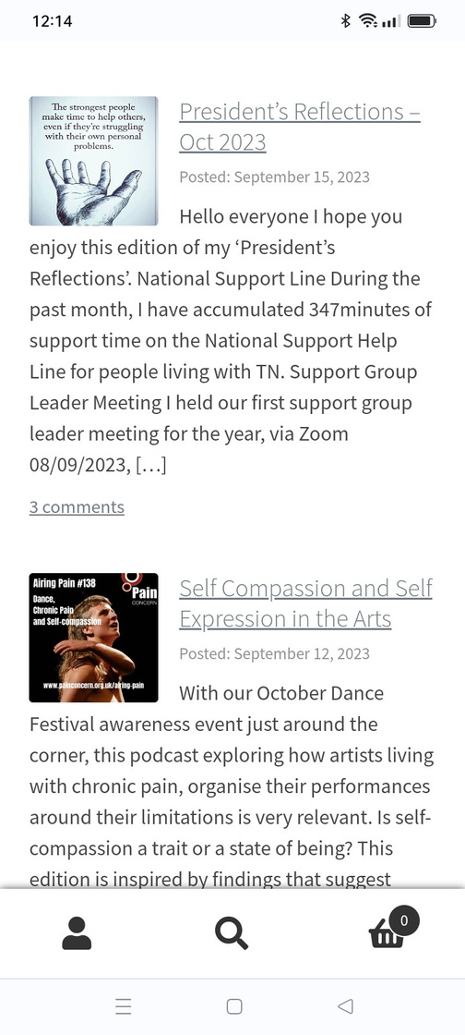
News * - High level
The first part of the page covers
  Beacon of Hope image
  You are not Alone animation
  Light up in Teal 2022/2023 Campaign
The next section is regulary updated with interesting articles research papers and podcasts and is broken down into the below categories
  All News
  Hints & Tips
  Events
  Studies and Research

Slide 26
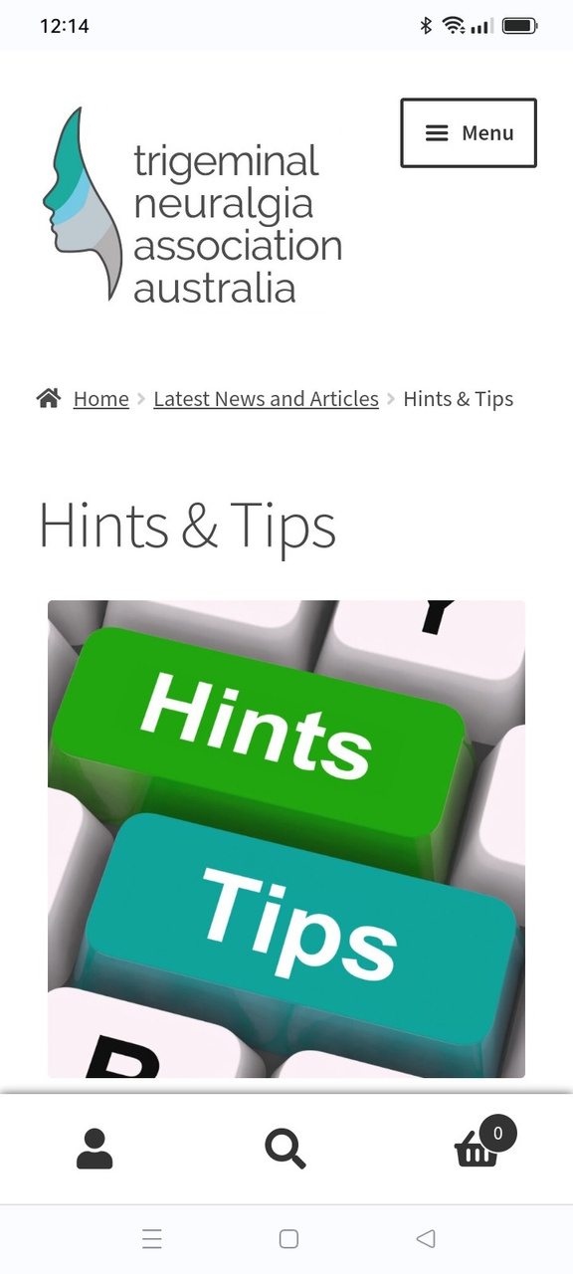
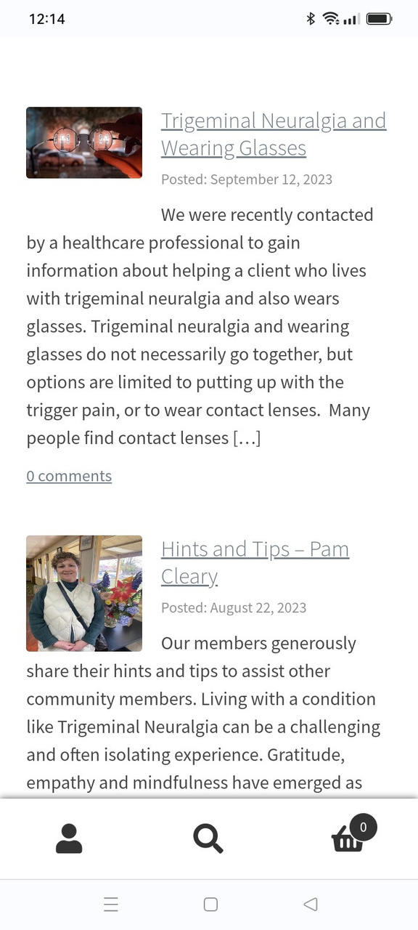
Hints & Tips *
This section is a new initiative to allow users to send in their hints & tips for managing trigeminal neuralgia in their lives
Hopefully as website members become more interactive they can be incouraged to send their suggestions via our contact form

Slide 27
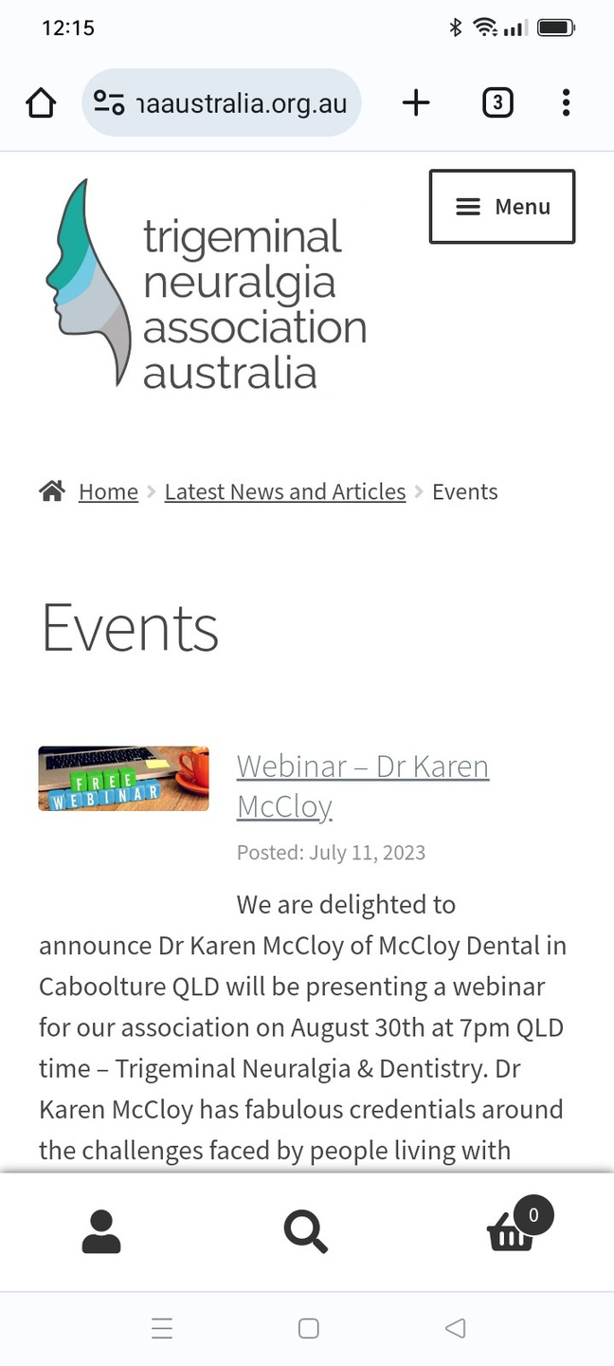
Events *
This section details upcoming events
  Webinar details
  Dance Show
  Volunteer workshop

Slide 28
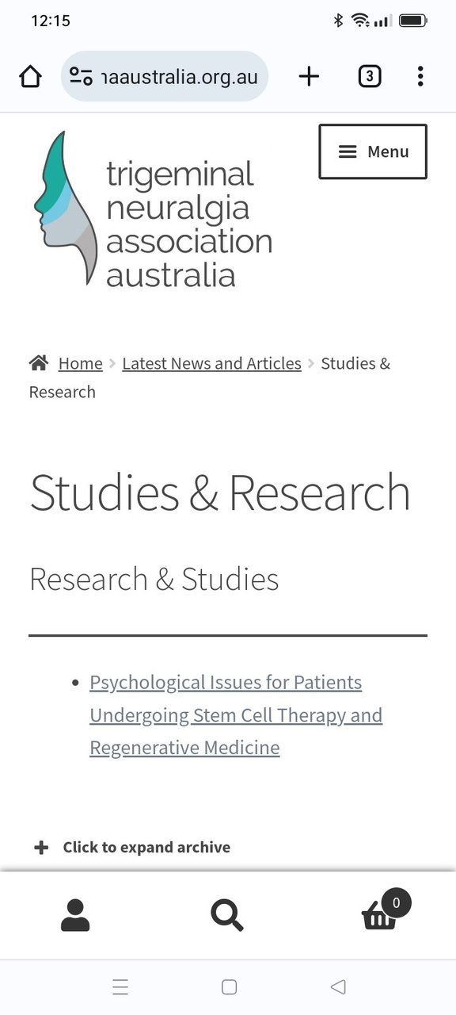
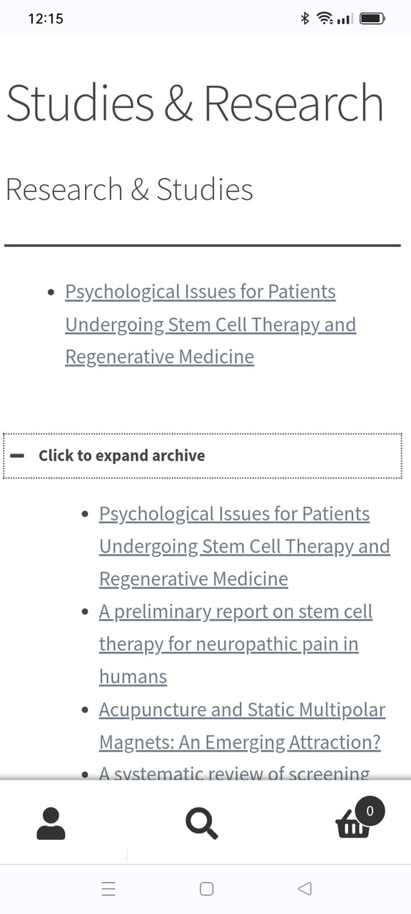
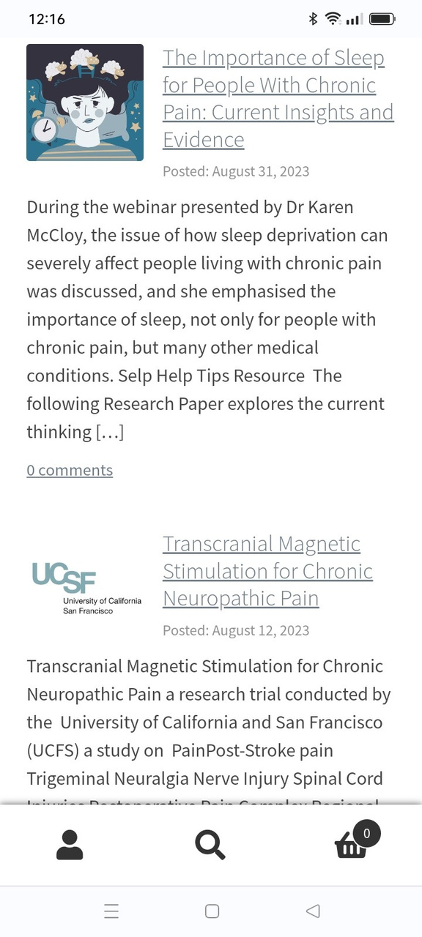
Studies and Research *
This section covers downloadable content and articles.
  The download section can be expanded by clicking the + sign
  The latest document uploaded to the area is displayed as a default
  Articles may also contain download content

Slide 29
Section 4 - Other
How to navigate the Associations website
https://tnaaustralia.org.au

Slide 30
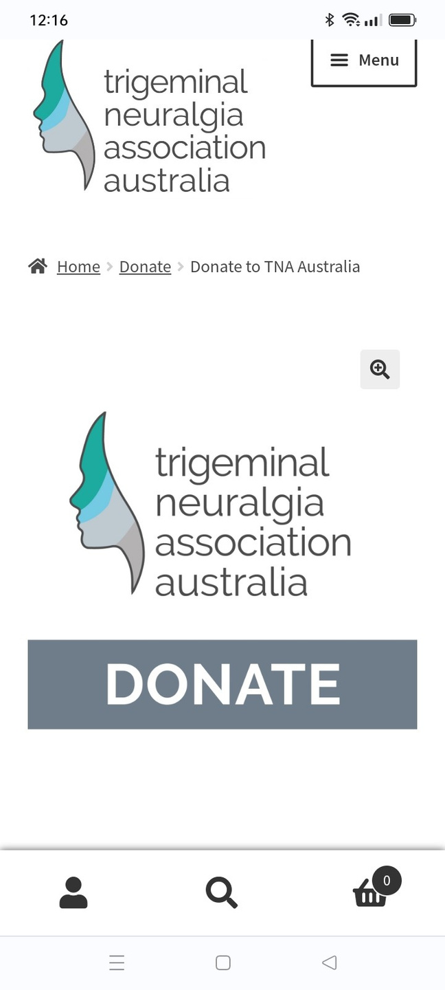
Donate
Donations can be made either on this link or on the home page of the website
Donators can choose to complete all details eg name address or can make the donation anonymously by ticking the box

Slide 31
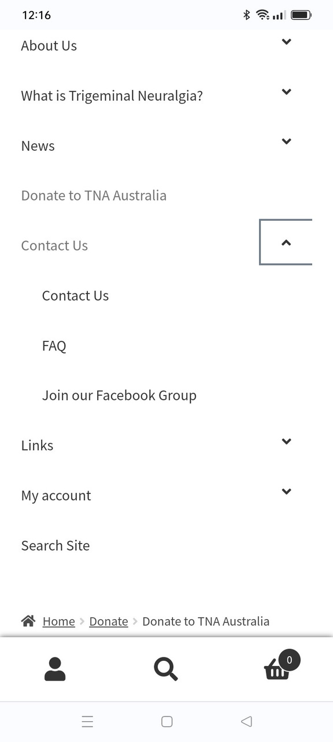
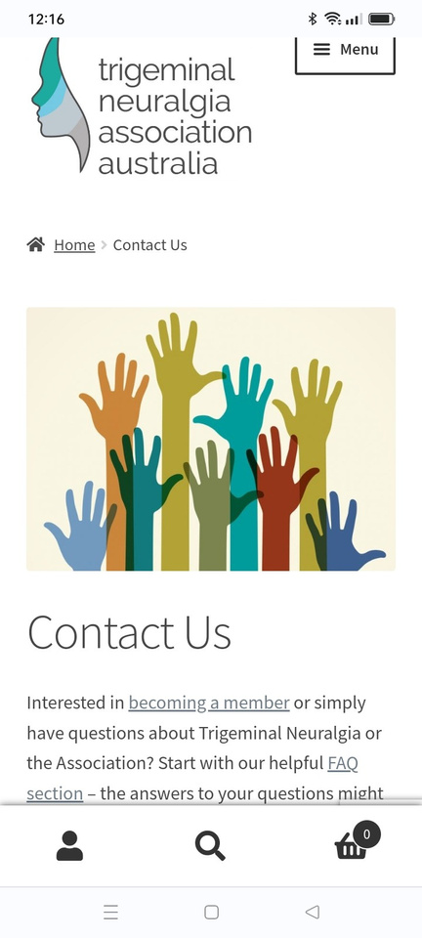
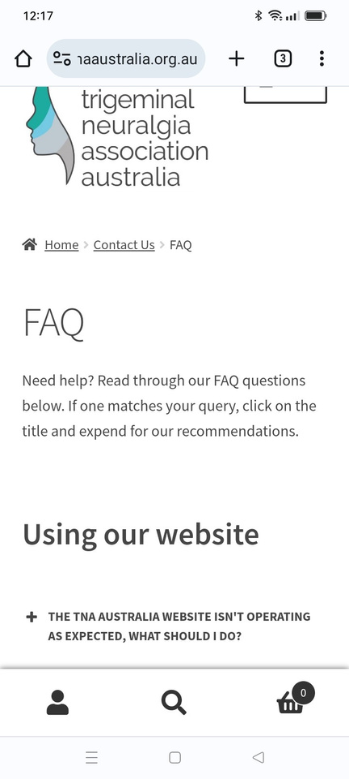
Contact Us - High Level
This is the main contact form for users.
  Complete personal details
  Add the details of enquiry
Click on arrow for further options
  FAQs - Frequently asked questions
  Join our Facebook Group - direct link to Facebook

Slide 32
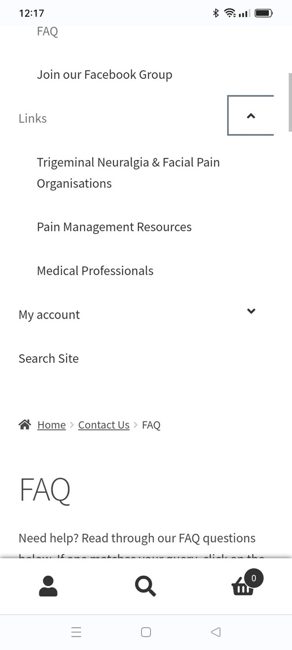
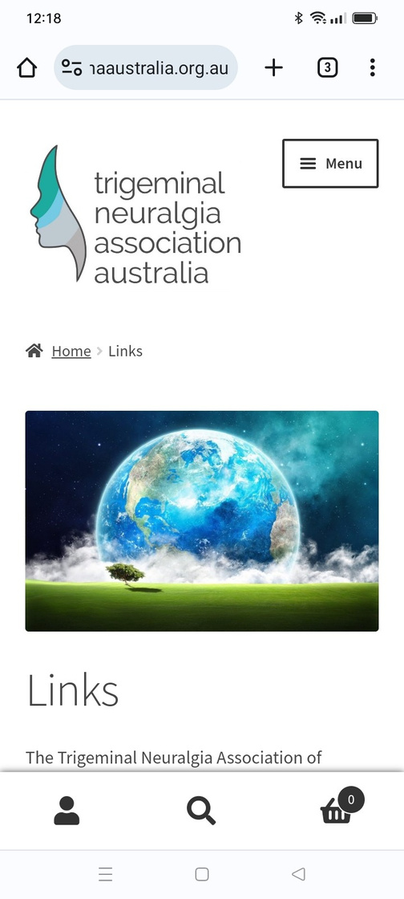
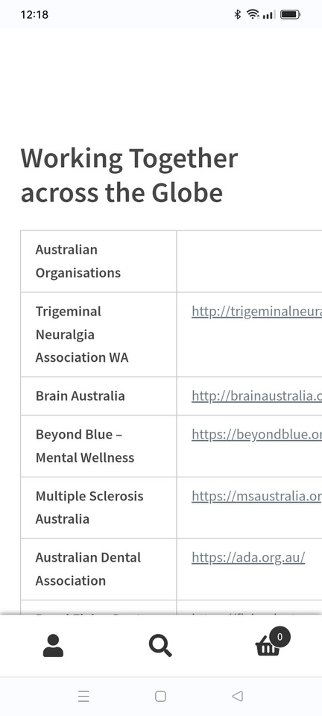
Links - High Level
Click on this link to display the full links table display scroll down the page to see content. This page also contains a link to the Associations ENEWS Archive
Links - Low level
  Trigeminal Neuralgia and Facial Pain Organisations
  Pain Management Resources
  Medical Professionals

Slide 33
Section 5 - My Account
How to navigate the Associations website
https://tnaaustralia.org.au

Slide 34
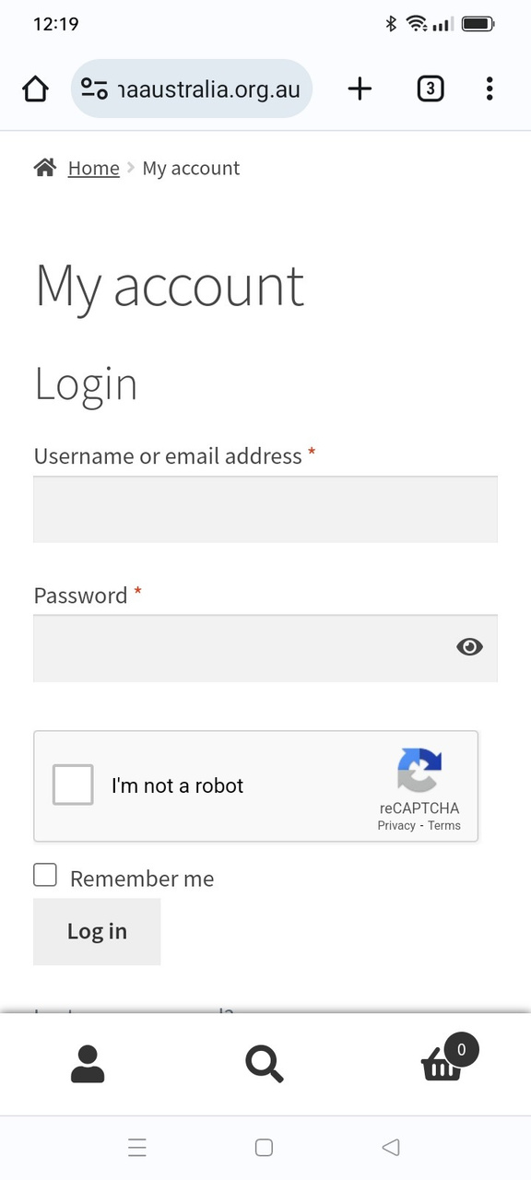

My Account - High Level
Click on this link to display the full list of options within My Account - enter your username (defaults to email) and password
  Dashboard
  Orders
  Membership
  Addresses
  Account Details
  Log Out

Slide 35



My Account - Content
Click on this link to display the full list of options for My Account - enter your username (defaults to email) and password
  My Profile
  Orders
  Membership
  Addresses
  Account Details
  Log Out

Slide 36

My Account Options - After Login to My Account
Click on this link to display quick links for members -
  Memberships (repeated link)
  Merchandise
  Orders (repeated link)
  Members Library
  Member Stories
  Digital Outreach and Training
  Support Group Leader

Slide 37


My Account Options - Before Login to My Account
Click on this link to display quick links for members -
  Memberships -System will prompt you to login
  Merchandise - will open a list of merchandise - scroll down to see options
  Orders -System will prompt you to login

Slide 38
My Account Options - After Login to My Account click on the arrow
After login to My Account extra options are displayed
  Members Library
  Digital Outreach and Training
  Support Group Leader

Slide 39
Members Library
After login to My Account extra options are displayed. There are several sections to scroll through on the page
  Members Information - downloads
  Support Group Meeting Reports - downloads
  TNA Australia Newsletter Archive- downloads
  Nominate your Committee - Information and Form
  Surveys - external survey
  Professional Articles - extracts from Striking Back
  Member News - articles and information

Slide 40

Membership Information
  Download resources and information sheets.
  These downloads are predominantly only available to members
  The items are ordered by publication date and the newest is at the top of the list
Click on the title to download the document

Slide 41


Support Group Meeting Reports
  Download minutes of support group meetings
  The latest report is shown
  To open the complete list of reports click on the plus sign
  Reports are ordered based on publication date
Click on the title to download the document

Slide 42


TNA Australia Newsletter Archive
  Download non digital newsletter
  The latest newsletter is shown
  To open the complete list of reports click on the plus sign
  Newsletters are ordered based on publication date
Click on the title to download the document
NB - ENEWS archive link is found on the Link page

Slide 43



Nominate Your Committee / Survey
  Click on the Electronic Committee Nomination Form
  The NYC page will display with details of
    AGM
    Committee member responsibilities
    How to Vote instructions
  The form is electronic and collected data is stored in the website database
  Survey is external and data expired

Slide 44

Professional Articles
Scroll down to this section
  This section is reproducing the text from the Striking Back edition with the approval from the Facial Pain Association (FPA)
  Chapters are posted every couple of months and are advertised as being avialble via our National Facebook Page

Slide 45

Member News
Scroll down to this section
  Articles of interest are categorised as Member News only if the information has not been obtained via the open internet
  General News is available to members and non members
  However to help members access this while in the members library - all published news can be found here

Slide 46



Member Stories
This section details individuals stories about their trigeminal neuralgia journey
  Members must be logged into My Account
  Complete the Form with personal details and story
  TNAA Admin will review and publish the article

Slide 47
Section 6 - Training Resources
How to navigate the Associations website
https://tnaaustralia.org.au

Slide 48

Digital Outreach and Training
This section has not yet been developed. It was envisioned that the page would contain resources for members living with trigeminal neuralgia.
Currently the only link on the page is to the Video Presentations which can also be accessed under the heading What is Trigeminal Neuralgia?

Slide 49


Support Group Leader
Members can apply to become a Support Group Leader by completing the form on this page.
The page describes the role of the Support Group Leader, what is involved in running a group, and the expectations of the Association

Slide 50


Training Resources - Part 1
When a volunteer becomes a Support Group Leader Trainee, their account will be given access to the Training Resources developed to train all volunteers. The page covers
  Standards
  SGL Meeting Resources
  Volunteer Induction
    8 x Information Sections
    Feedback forms
    Acknowledgement form
    Other Resources

Slide 51



Training Resources - Part 2
The Association strives to ensure all SGL volunteers understand key information about trigeminal neuralgia
  The Trigeminal Nerve
    6 x Lessons and Quiz
    3 x Other Resources
  TN Treatments
    6 x Lesssons and Quiz
    4 x Other Resources
  Pain Management & Quality of Life
    6 x Lesson and Quiz
    6 x Other Resources
\

Slide 52



Training Resources - Part 3
The final sections cover the Association Responsibility Leadership and Counselling
  Support Leader Responsibiity
    8 x Resources and Feedback
    2 x Other Resources
  Committee Member Training
    2 x Free ACNC courses
    6 x Other Resources
  Counselling Training
    The Association purchased various modules to assist volunteers learn how to help safely
\

Slide 53
Section 7 - Other
How to navigate the Associations website
https://tnaaustralia.org.au

Slide 54




Search Site - Function
The website has a search function which works well if the title of an article matches the search criteria. It is not however a sophisticated search engine.

Slide 55
Final Page Left Blank
55 x slide presentation
How to navigate the Associations website
https://tnaaustralia.org.au

